Slide 1


Arts Department
HAZCOM (Hazard Communication) and Exposure Routes
Anne Kogut, CIH,CSP
Industrial Hygiene Manager
Hazardous Waste
June Brock-Carroll, LVT, CHMP
Hazardous Materials Manager

Slide 2
Arts Department: with your attendance of a live training session…
HAZCOM (Hazard Communication)– training certification; why it is required; your responsibilities
Exposure Routes- valuable information to know about products you may use.
Hazardous Waste– training certification; why it is required; your responsibilities

Slide 3

What is Hazard Communication?
1983 – Federal Government established OSHA’s HAZCOM or HCS
2012 – Standard aligned with United Nation’s Globally Harmonized System (GHS) of Classification and Labeling
What is the Goal of Hazard Communication?
Protect workers who are exposed to hazardous chemicals.
Employers are responsible for informing employees of hazards and identities
of workplace chemicals to which they are exposed. You have a right to
know what you are working with and potential effects of these materials on
your health and safety.
Notes:
Editorial Guidelines on Bullets:
1. Vertical lists are best introduced by a grammatically complete sentence followed by a colon. No periods
are required at the end of entries unless at least one entry is a complete sentence, in which case a period
is necessary at the end of each entry.
Example: A university can be judged by three measures:
· The quality of its students
· The quality of it faculty
· The quality of its infrastructure
2. If a list completes the sentence that introduces it, items begin with lowercase letters, commas or semicolons
(if individual items contain commas) are used to separate each item, and the last item ends with a period.
Note that the introductory clause does not end with a colon.
Example: A university can be judged by
· the quality of its students,
· the quality of its faculty,
· the quality of its infrastructure.
3. Avoid mixing sentence and nonsentence items in a bulleted list.
3

Slide 4
Why GHS?
Many different countries have different systems for classification and labeling. Several different systems can exist even within the same country.
What’s wrong with having different systems?
  Expensive for governments to regulate and enforce
  Costly for companies to comply with
  Confusing for workers to understand hazards
Confusion on communication of the hazards an international Problem for daily use & emergency response

Slide 5
5 Elements of Your Right-To-Know:
Written Policy
Labeling
Safety Data Sheets
Chemical Inventory
Training & Safety Awareness
Notes:
Editorial Guidelines on Bullets:
1. Vertical lists are best introduced by a grammatically complete sentence followed by a colon. No periods
are required at the end of entries unless at least one entry is a complete sentence, in which case a period
is necessary at the end of each entry.
Example: A university can be judged by three measures:
· The quality of its students
· The quality of it faculty
· The quality of its infrastructure
2. If a list completes the sentence that introduces it, items begin with lowercase letters, commas or semicolons
(if individual items contain commas) are used to separate each item, and the last item ends with a period.
Note that the introductory clause does not end with a colon.
Example: A university can be judged by
· the quality of its students,
· the quality of its faculty,
· the quality of its infrastructure.
3. Avoid mixing sentence and nonsentence items in a bulleted list.
5

Slide 6
These are the Harmonized Elements
Classify
Criteria to Classify
Communicate
Pictogram
Communicate
Safety Data Sheets (SDSs)
Communicate
Label
Chemical
Physical
Environmental
GHS

Slide 7
What are the Major Changes?
Hazard Classification – definition of a hazard was changed, provide specific criteria for classification of health and physical hazards.
Labeling – manufacturer will be required to provide a label that includes a harmonized signal word, pictogram, hazard statement, and precautionary statement.
Safety Data Sheets – will now have a specified 16 section format.
Notes:
Editorial Guidelines on Bullets:
1. Vertical lists are best introduced by a grammatically complete sentence followed by a colon. No periods
are required at the end of entries unless at least one entry is a complete sentence, in which case a period
is necessary at the end of each entry.
Example: A university can be judged by three measures:
· The quality of its students
· The quality of it faculty
· The quality of its infrastructure
2. If a list completes the sentence that introduces it, items begin with lowercase letters, commas or semicolons
(if individual items contain commas) are used to separate each item, and the last item ends with a period.
Note that the introductory clause does not end with a colon.
Example: A university can be judged by
· the quality of its students,
· the quality of its faculty,
· the quality of its infrastructure.
3. Avoid mixing sentence and nonsentence items in a bulleted list.
7

Slide 8
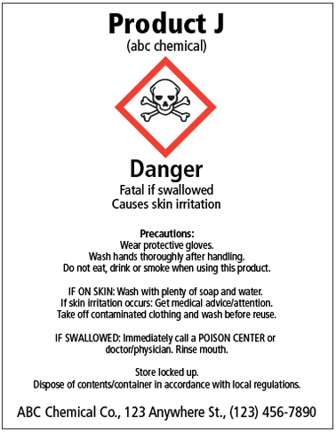
Labels
Most immediate source of information - directly on container and quick reference of hazards.
  Product Identifier
  Pictogram(s)
  Signal Word – Only one listed
    Danger – Highest Hazard
    Warning – Lower Hazard
  Hazard Statement
  Precautionary Statement
  Supplier Information
Notes:
Editorial Guidelines on Bullets:
1. Vertical lists are best introduced by a grammatically complete sentence followed by a colon. No periods
are required at the end of entries unless at least one entry is a complete sentence, in which case a period
is necessary at the end of each entry.
Example: A university can be judged by three measures:
· The quality of its students
· The quality of it faculty
· The quality of its infrastructure
2. If a list completes the sentence that introduces it, items begin with lowercase letters, commas or semicolons
(if individual items contain commas) are used to separate each item, and the last item ends with a period.
Note that the introductory clause does not end with a colon.
Example: A university can be judged by
· the quality of its students,
· the quality of its faculty,
· the quality of its infrastructure.
3. Avoid mixing sentence and nonsentence items in a bulleted list.
8

Slide 9
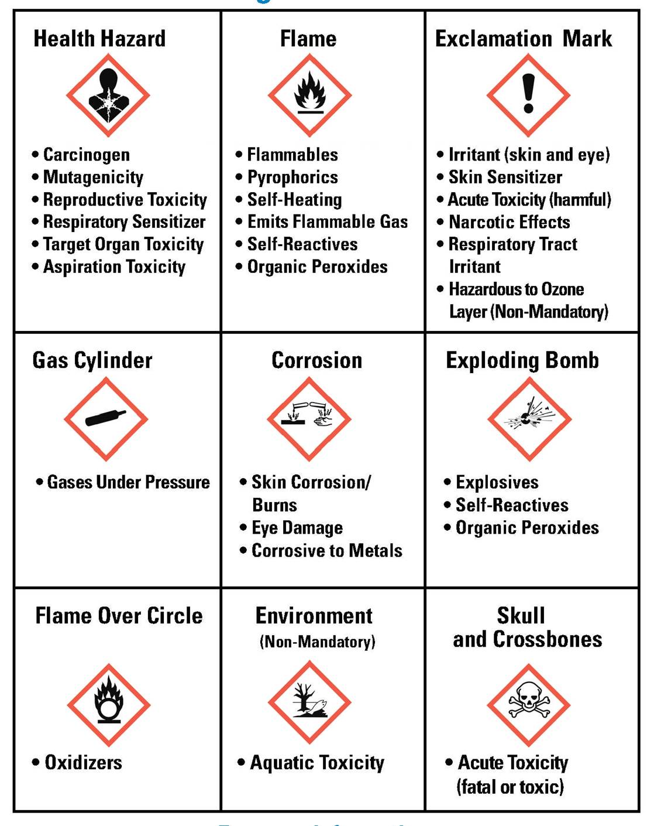
Pictograms
Found on labels
Found on SDSs
Based on specific criteria
Identifies specific hazards
Notes:
Editorial Guidelines on Bullets:
1. Vertical lists are best introduced by a grammatically complete sentence followed by a colon. No periods
are required at the end of entries unless at least one entry is a complete sentence, in which case a period
is necessary at the end of each entry.
Example: A university can be judged by three measures:
· The quality of its students
· The quality of it faculty
· The quality of its infrastructure
2. If a list completes the sentence that introduces it, items begin with lowercase letters, commas or semicolons
(if individual items contain commas) are used to separate each item, and the last item ends with a period.
Note that the introductory clause does not end with a colon.
Example: A university can be judged by
· the quality of its students,
· the quality of its faculty,
· the quality of its infrastructure.
3. Avoid mixing sentence and nonsentence items in a bulleted list.
9

Slide 10
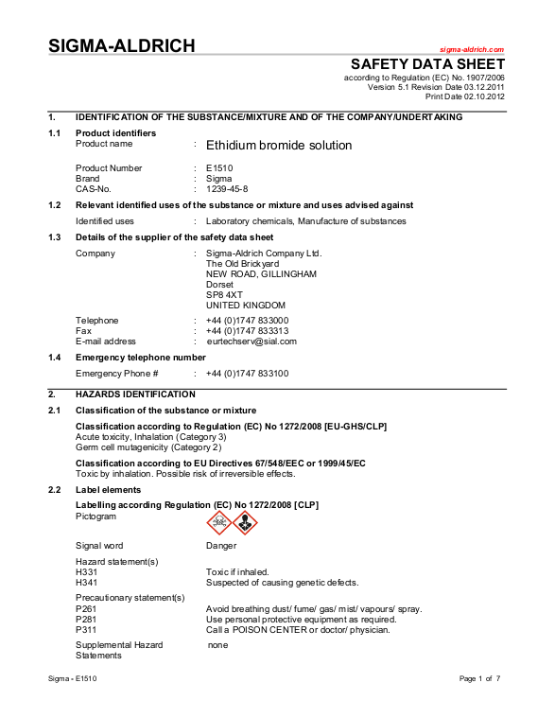
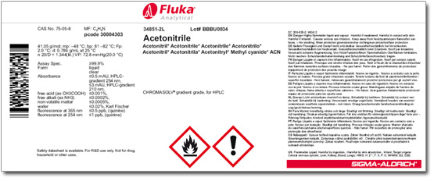
Be able to recognize chemical hazards
Chemical Hazard Information can be found on:
Primary container labels
Safety Data Sheets (SDS)
Information from the Grad students or faculty

Slide 11

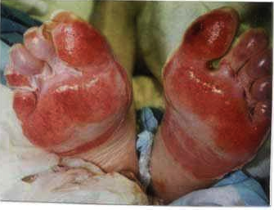
10 - Health Hazards
Acute Toxicity
Skin Corrosion/Irritation
Serious Eye Damage/Eye Irritation
Respiratory or Skin Sensitization
Germ Cell Mutagenicity
Carcinogenicity
Reproductive Toxicity
Specific Target Organ Toxicity –
Single Exposure
Specific Target Organ Toxicity –
Repeated Exposure
Aspiration Hazard
Notes:
Editorial Guidelines on Bullets:
1. Vertical lists are best introduced by a grammatically complete sentence followed by a colon. No periods
are required at the end of entries unless at least one entry is a complete sentence, in which case a period
is necessary at the end of each entry.
Example: A university can be judged by three measures:
· The quality of its students
· The quality of it faculty
· The quality of its infrastructure
2. If a list completes the sentence that introduces it, items begin with lowercase letters, commas or semicolons
(if individual items contain commas) are used to separate each item, and the last item ends with a period.
Note that the introductory clause does not end with a colon.
Example: A university can be judged by
· the quality of its students,
· the quality of its faculty,
· the quality of its infrastructure.
3. Avoid mixing sentence and nonsentence items in a bulleted list.
11

Slide 12
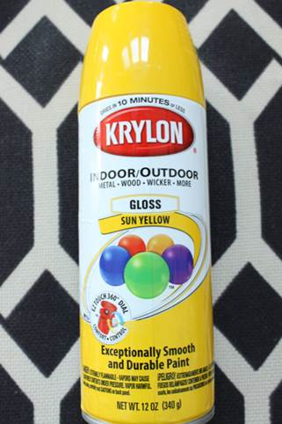
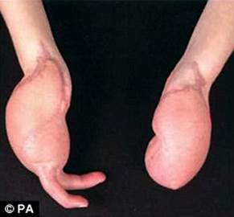
16 - Physical Hazards
Explosives
Flammable Gases
Flammable Aerosols
Oxidizing Gases
Gases Under Pressure
Flammable Liquids
Flammable Solids
Self-Reactives
Pyrophoric Liquids
Pyrophoric Solids
Self-Heating Chemicals
Chemicals when in contact with water
emit flammable gases
Oxidizing Liquids
Oxidizing Solids
Organic Peroxides
Corrosive to Metals
Notes:
Editorial Guidelines on Bullets:
1. Vertical lists are best introduced by a grammatically complete sentence followed by a colon. No periods
are required at the end of entries unless at least one entry is a complete sentence, in which case a period
is necessary at the end of each entry.
Example: A university can be judged by three measures:
· The quality of its students
· The quality of it faculty
· The quality of its infrastructure
2. If a list completes the sentence that introduces it, items begin with lowercase letters, commas or semicolons
(if individual items contain commas) are used to separate each item, and the last item ends with a period.
Note that the introductory clause does not end with a colon.
Example: A university can be judged by
· the quality of its students,
· the quality of its faculty,
· the quality of its infrastructure.
3. Avoid mixing sentence and nonsentence items in a bulleted list.
12

Slide 13
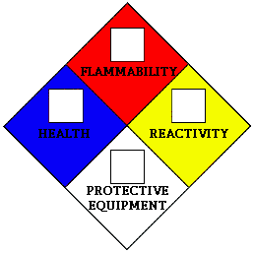

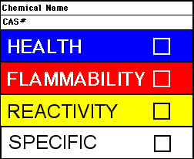
HMIS & NFPA – In House Labeling
Alternate labeling systems such as HMIS (Hazardous Materials Identification System) and NFPA (National Fire Protection Association) may still be found. One concern is that currently, the HMIS/NFPA and GHS hazard criteria are different.
GHS Hazard Categories
Cat. 1 = Severe Hazard
Cat. 2 = Serious Hazard
Cat. 3 = Moderate Hazard
Cat. 4 = Slight Hazard
Cat. 5 = Minimal Hazard
HMIS/NFPA Hazard Ratings
0 = Minimal Hazard
1 = Slight Hazard
2 = Moderate Hazard
3 = Serious Hazard
4 = Severe Hazard
Notes:
Editorial Guidelines on Bullets:
1. Vertical lists are best introduced by a grammatically complete sentence followed by a colon. No periods
are required at the end of entries unless at least one entry is a complete sentence, in which case a period
is necessary at the end of each entry.
Example: A university can be judged by three measures:
· The quality of its students
· The quality of it faculty
· The quality of its infrastructure
2. If a list completes the sentence that introduces it, items begin with lowercase letters, commas or semicolons
(if individual items contain commas) are used to separate each item, and the last item ends with a period.
Note that the introductory clause does not end with a colon.
Example: A university can be judged by
· the quality of its students,
· the quality of its faculty,
· the quality of its infrastructure.
3. Avoid mixing sentence and nonsentence items in a bulleted list.
13

Slide 14
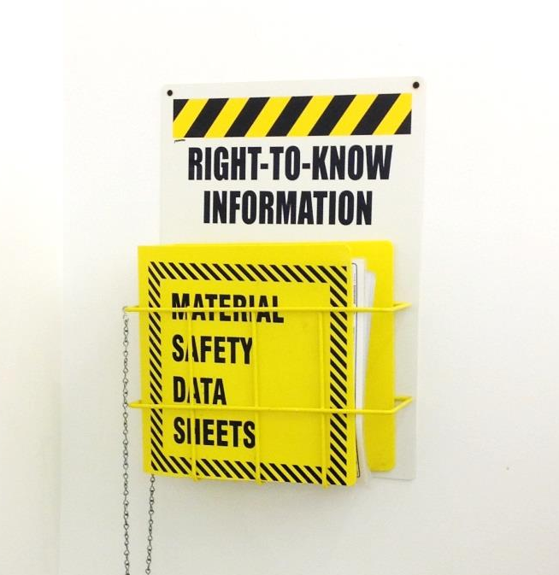
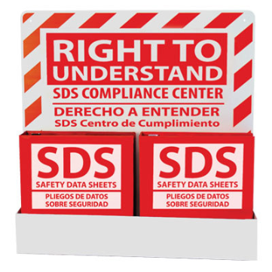
Safety Data Sheets–formerly Material Safety Data Sheets
A Safety Data Sheet, SDS, is an additional reference and provides very detailed information regarding health and physical hazards of a chemical.
Will be required to follow a specific format which features 16 sections in a strict ordering.
SDS must be available to those working with the chemical.
It’s your responsibility to review and understand the information in the SDS.
Notes:
Editorial Guidelines on Bullets:
1. Vertical lists are best introduced by a grammatically complete sentence followed by a colon. No periods
are required at the end of entries unless at least one entry is a complete sentence, in which case a period
is necessary at the end of each entry.
Example: A university can be judged by three measures:
· The quality of its students
· The quality of it faculty
· The quality of its infrastructure
2. If a list completes the sentence that introduces it, items begin with lowercase letters, commas or semicolons
(if individual items contain commas) are used to separate each item, and the last item ends with a period.
Note that the introductory clause does not end with a colon.
Example: A university can be judged by
· the quality of its students,
· the quality of its faculty,
· the quality of its infrastructure.
3. Avoid mixing sentence and nonsentence items in a bulleted list.
14

Slide 15
SDS Sections
Section 1 – Identification
Section 2 – Hazards Identification
Section 3 – Composition of Ingredients
Section 4 – First Aid
Section 5 – Fire Fighting
Section 6 – Accidental Release
Section 7 – Handling and Storage
Section 8 – Exposure and Personal Protection
Section 9 – Physical and Chemical Characteristics
Section 10 – Stability and Reactivity
Section 11 – Toxicological Information
Section 12 – Ecological Info
Section 13 – Disposal Info
Section 14 – Transportation Info
Section 15 – Regulatory Info
Section 16 – Other Info – Revision dates, Legends, HMIS/NFPA, etc.
Notes:
Editorial Guidelines on Bullets:
1. Vertical lists are best introduced by a grammatically complete sentence followed by a colon. No periods
are required at the end of entries unless at least one entry is a complete sentence, in which case a period
is necessary at the end of each entry.
Example: A university can be judged by three measures:
· The quality of its students
· The quality of it faculty
· The quality of its infrastructure
2. If a list completes the sentence that introduces it, items begin with lowercase letters, commas or semicolons
(if individual items contain commas) are used to separate each item, and the last item ends with a period.
Note that the introductory clause does not end with a colon.
Example: A university can be judged by
· the quality of its students,
· the quality of its faculty,
· the quality of its infrastructure.
3. Avoid mixing sentence and nonsentence items in a bulleted list.
15

Slide 16
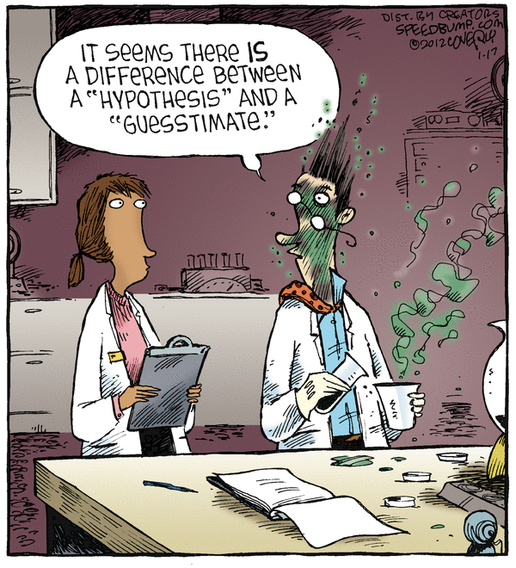
What Makes A Chemical A HAZARD
1. Has an inherent ability to do harm:
TOXIC
FLAMMABLE
Explosive
2. The Ease which contact can be established

Slide 17
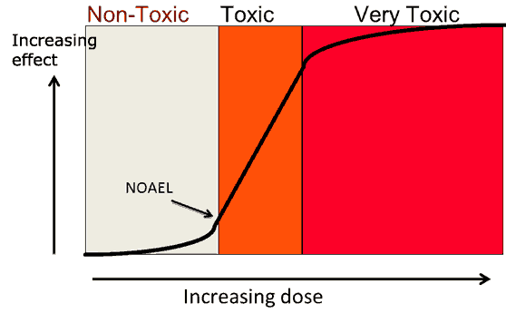
“All substances are poisons: there is none which is not a poison. The right dose differentiates a poison and a remedy.”
Paracelsus (1493-1541)

Slide 18
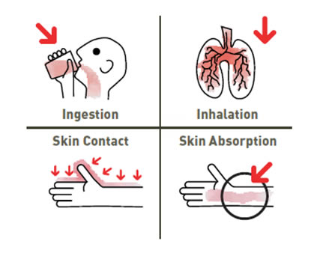
Routes of Exposure

Slide 19

Terms
Acute health effects
Chronic health effects
Sensitivity vs. “Sensitization”

Slide 20



Carcinogen
Mutagen
Teratogen

Slide 21

Terms
Parts Per Million (ppm)
Permissible Exposure Limits (PEL’s)
Threshold Limit Values (TLV’s)

Slide 22
Part Per Million (PPM)
Four drops of ink in one 55 gallon barrel
1 inch in 16 miles
One second in 11.5 days
One minute in two years
One ounce in 32 tons
One cent in $10,000

Slide 23
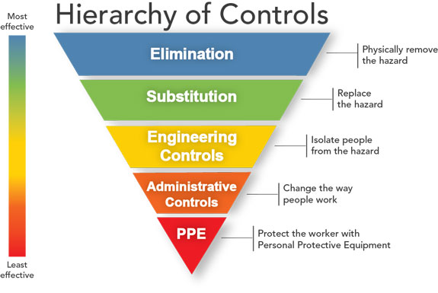
Controlling the Hazards

Slide 24
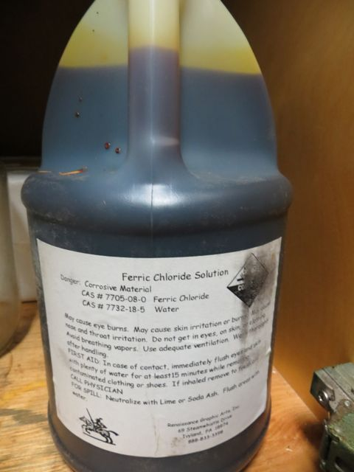
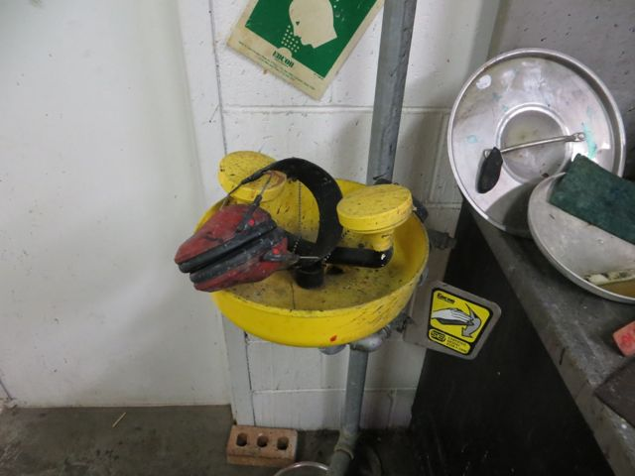
Arts Hazards Cont.
Printmaking:
Acids in etching may cause severe skin burns & eye damage from splashes.
Lead pigments found in chromate and molybdate-based inks
Etching grounds contain asphaltum, a skin irritant and rosin, which causes hay fever-like symptoms and possible asthma
Liquid grounds can contain solvents like benzene and methyl chloroform, which overexposure can be very dangerous
Properly labeled container, spillage alongside container should be wiped off.
Hearing protection inside the emergency eye wash?
Notes:
Editorial Guidelines on Bullets:
1. Vertical lists are best introduced by a grammatically complete sentence followed by a colon. No periods
are required at the end of entries unless at least one entry is a complete sentence, in which case a period
is necessary at the end of each entry.
Example: A university can be judged by three measures:
· The quality of its students
· The quality of it faculty
· The quality of its infrastructure
2. If a list completes the sentence that introduces it, items begin with lowercase letters, commas or semicolons
(if individual items contain commas) are used to separate each item, and the last item ends with a period.
Note that the introductory clause does not end with a colon.
Example: A university can be judged by
· the quality of its students,
· the quality of its faculty,
· the quality of its infrastructure.
3. Avoid mixing sentence and nonsentence items in a bulleted list.
24

Slide 25
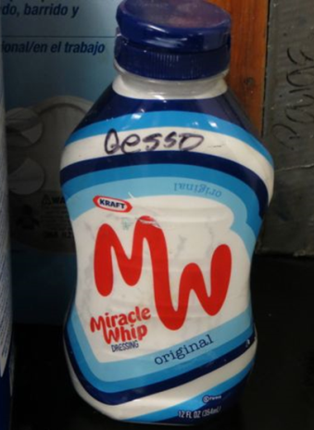
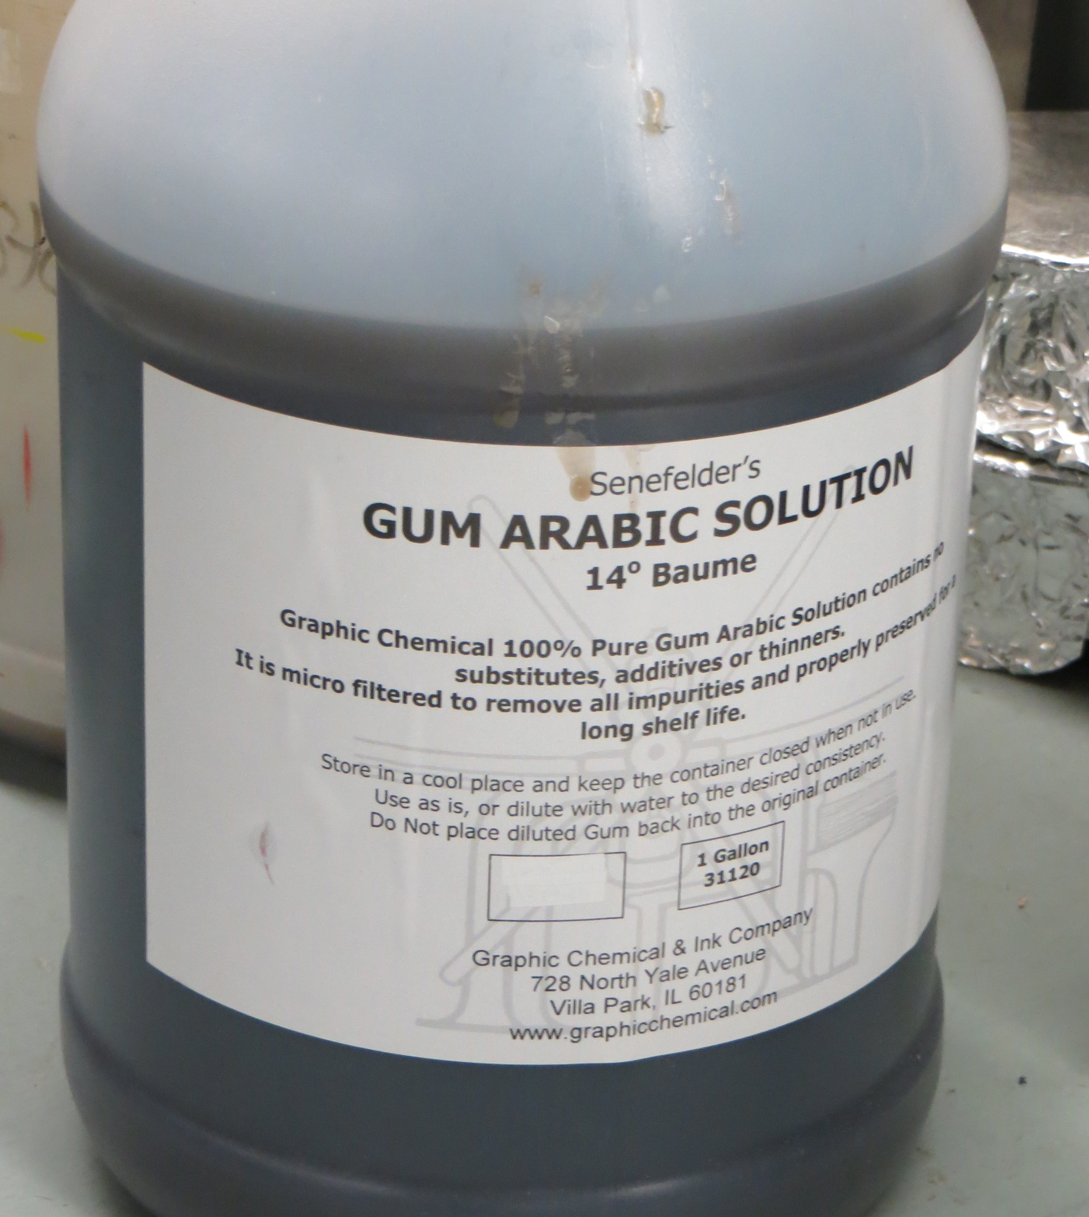
What are Some HAZARDS in the Art Department?
Painting and Drawing:
Inhaling dust from powdered pigments
Inorganic pigments made of toxic compounds may be
carcinogenic: flake white, naples yellow, vermillion and
mercury based pigments.
Accidental ingestion of pigments
Pointing the brush with your mouth, eating, drinking,
smoking, applying chapstick or makeup, taking
medications can result in chronic poisoning.
Solvent based ink and markers
May cause liver damage if used long-term xylene based
Paint Binders
Mineral spirits & turpentine are hazardous by skin contact,
inhalation, & ingestion.
Lacquer thinner contains dangerous solvents
like toluene which is highly flammable.
Gesso in a mayo container?
Proper labeling, in original container.
Notes:
Editorial Guidelines on Bullets:
1. Vertical lists are best introduced by a grammatically complete sentence followed by a colon. No periods
are required at the end of entries unless at least one entry is a complete sentence, in which case a period
is necessary at the end of each entry.
Example: A university can be judged by three measures:
· The quality of its students
· The quality of it faculty
· The quality of its infrastructure
2. If a list completes the sentence that introduces it, items begin with lowercase letters, commas or semicolons
(if individual items contain commas) are used to separate each item, and the last item ends with a period.
Note that the introductory clause does not end with a colon.
Example: A university can be judged by
· the quality of its students,
· the quality of its faculty,
· the quality of its infrastructure.
3. Avoid mixing sentence and nonsentence items in a bulleted list.
25

Slide 26
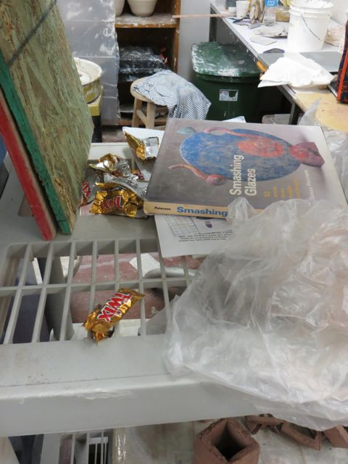
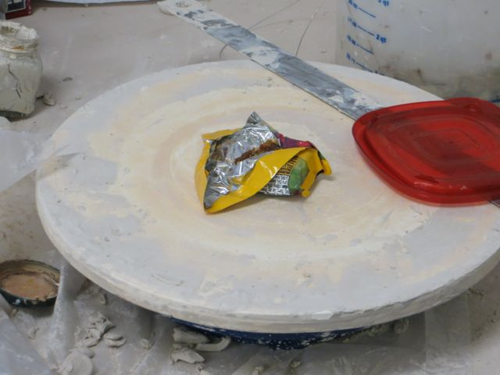
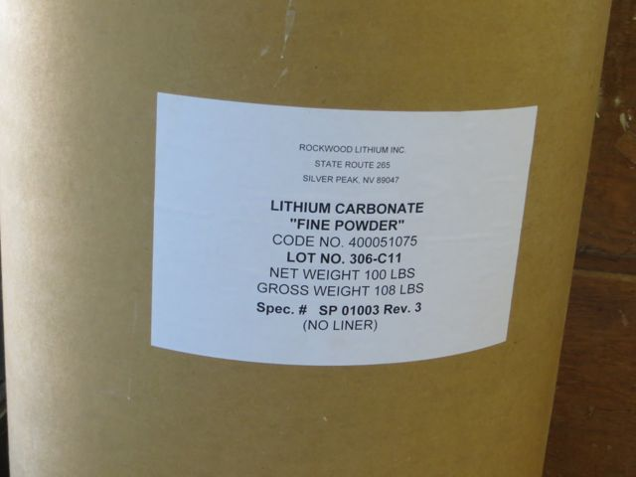
Arts Hazards Cont.
Ceramics:
Silicates in clay. Inhalation of silica dust can lead to shortness of breath decreased chest expansion, increased susceptibility to infections, and scarring of the lungs.
Many low fire clays and slip casting clays contain talc, which may be
contaminated with Asbestos. Over years may can lead to lung cancer.
Glazes may also contain silica, asbestos, alkali oxides and toxic metals such as
lead, barium and lithium.
Toxic fumes and gases from the firing process including carbon monoxide, sulphur dioxide, and formaldehyde. Fluorine and chlorine gases are emitted when raw glazes break down into oxides.
Take breaks away from your work area.
Properly labeled container.
Notes:
Editorial Guidelines on Bullets:
1. Vertical lists are best introduced by a grammatically complete sentence followed by a colon. No periods
are required at the end of entries unless at least one entry is a complete sentence, in which case a period
is necessary at the end of each entry.
Example: A university can be judged by three measures:
· The quality of its students
· The quality of it faculty
· The quality of its infrastructure
2. If a list completes the sentence that introduces it, items begin with lowercase letters, commas or semicolons
(if individual items contain commas) are used to separate each item, and the last item ends with a period.
Note that the introductory clause does not end with a colon.
Example: A university can be judged by
· the quality of its students,
· the quality of its faculty,
· the quality of its infrastructure.
3. Avoid mixing sentence and nonsentence items in a bulleted list.
26

Slide 27
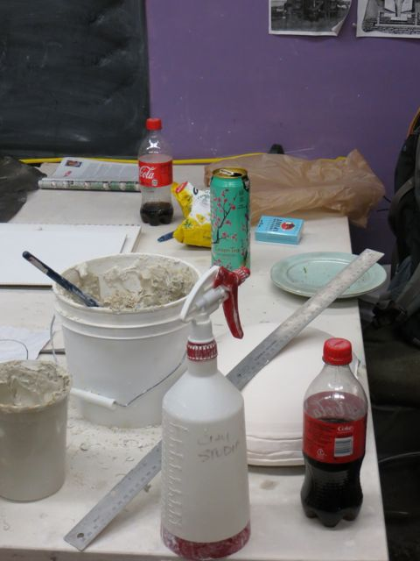
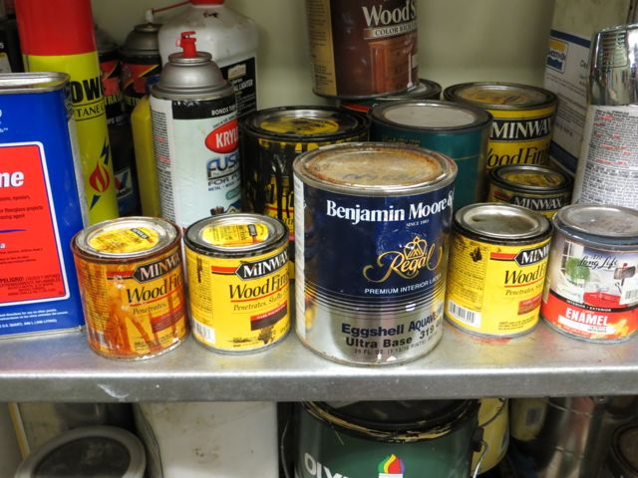
Arts Hazards Cont.
Sculpture: Stone, Plaster, Wood, Plastic & Metals
Granite, quartz, sandstone, slate, and soapstone all contain free silica.
Soapstone, serpentine, and green stone also contain asbestos as a contaminant.
Chronic inhalation of sawdust can cause respiratory diseases.
Paint strippers and wood finishes contain toxic solvents like toluene, methyl
alcohol, and benzene which can cause leukemia.
Working with plastics such as acrylics, polyester resins, epoxy resins,
polyurethane, polystyrene, and fiberglass- be aware of
hazards from casting laminating, and foam processes,
and from overheating or burning plastics while sawing
and machining.
Properly labeled containers.
Not a good place for a break.
Notes:
Toxic gases can be released during the formation process of plastics from overheating finished plastics.
27

Slide 28


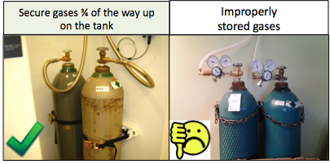
Other Hazards
Use of Cylinders – Hazards and information on Fact Sheets
Use of Cryogenics such as liquid nitrogen or dry ice.
Use of equipment
  Welding
  Hand tools
  Power Tools

Slide 29
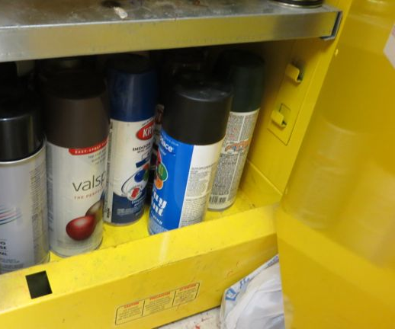
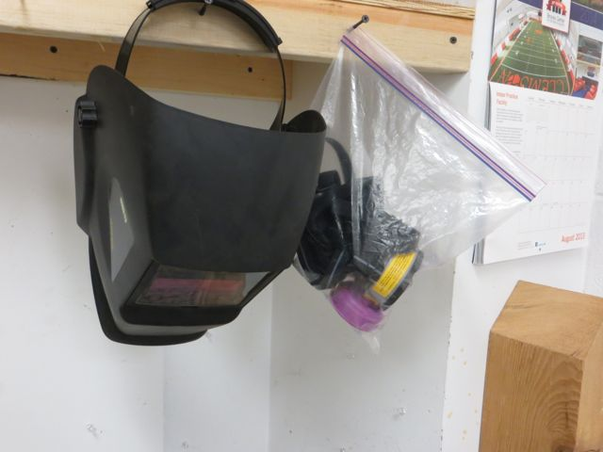

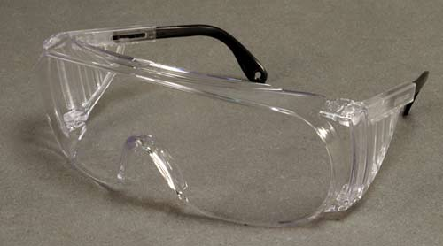
Examples of ways to protect yourself from Art HAZARDS
Read Labels and Safety Data Sheets-Know what you are working with.
Wear your Personal Protective Equipment (PPE)
  Wear gloves when working with paints, varnishes and binders.
  Wear faceshield/eye protection, acid/solvent resistant gloves
  and protective clothing when working with acids.
  Wear dust masks when needed.
Work in a well ventilated area.
Always label and store chemicals properly.
  Never use old food containers to store chemical in.
Always wash your hands before eating, drinking,
smoking, touching your face, or applying cosmetics.
Flush eye wash stations (weekly) and safety showers (monthly)
Notes:
Editorial Guidelines on Bullets:
1. Vertical lists are best introduced by a grammatically complete sentence followed by a colon. No periods
are required at the end of entries unless at least one entry is a complete sentence, in which case a period
is necessary at the end of each entry.
Example: A university can be judged by three measures:
· The quality of its students
· The quality of it faculty
· The quality of its infrastructure
2. If a list completes the sentence that introduces it, items begin with lowercase letters, commas or semicolons
(if individual items contain commas) are used to separate each item, and the last item ends with a period.
Note that the introductory clause does not end with a colon.
Example: A university can be judged by
· the quality of its students,
· the quality of its faculty,
· the quality of its infrastructure.
3. Avoid mixing sentence and nonsentence items in a bulleted list.
29

Slide 30
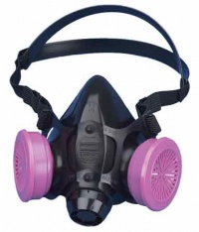
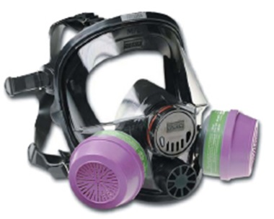
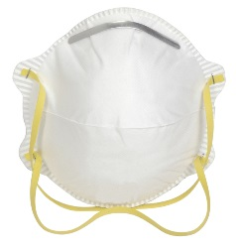
Respiratory Protection Program
29 CFR 1910.134 is the OSHA Respiratory Protection Standard, intended to protect workers who may exposed to a respiratory hazard and/or required to wear a respirator. Research Safety can assist in hazard analysis and determining if you need to be in the RPP.
Respiratory hazards may include: dusts, aerosols/mists, metal fumes, vapors, gases, biological agents, or oxygen-deficient atmospheres.
The preferred method of controlling respiratory hazards includes engineering and administrative controls. As a last resort, personal protective equipment such as respirators may be used to protect the worker.
If determined you are in the RPP, you must be enrolled in the medical surveillance program, participate in annual training, and be fit tested on your respirator annually.
Notes:
Editorial Guidelines on Bullets:
1. Vertical lists are best introduced by a grammatically complete sentence followed by a colon. No periods
are required at the end of entries unless at least one entry is a complete sentence, in which case a period
is necessary at the end of each entry.
Example: A university can be judged by three measures:
· The quality of its students
· The quality of it faculty
· The quality of its infrastructure
2. If a list completes the sentence that introduces it, items begin with lowercase letters, commas or semicolons
(if individual items contain commas) are used to separate each item, and the last item ends with a period.
Note that the introductory clause does not end with a colon.
Example: A university can be judged by
· the quality of its students,
· the quality of its faculty,
· the quality of its infrastructure.
3. Avoid mixing sentence and nonsentence items in a bulleted list.
30

Slide 31
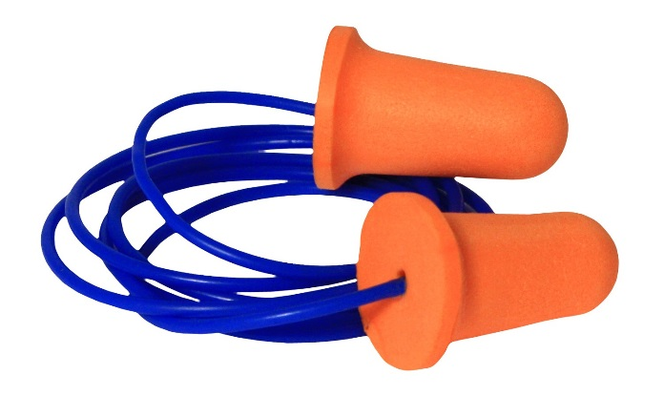

Hearing Conservation
29 CFR 1910.95 is the OSHA Occupational Noise Exposure Standard. The program applies to all operations where employees are exposed to noise levels of 85 decibels or above for an 8 hour time weighted average.
Rule of Thumb…If you must raise your voice to someone 3 feet away, you are in high noise.
Sound levels are measured by Research Safety using a dosimeter. Report noise hazards and hearing protection problems to you supervisor or Research Safety.
Once determined you are part of the HCP you must be enrolled in the medical surveillance program, have a baseline audiogram and annual audiogram, participate in annual training, and wear hearing protectors (such as earplugs, earmuffs, or both).

Slide 32
Incidents
Architecture Center: Student lost tips of 3 fingers when using guarded jointer
Cook Lab: Student had shirt pulled into operating lathe. No injuries
Wiser: Student broke knuckle and tore tendon while trying to guide a falling concrete wall.
AMRL: Two over pressurization lab incidents resulting in cuts and HF burns.
Various Shops and Labs: Chemicals in eye. Not wearing safety glasses or goggles or wrong type of eye protection.
Cook Lab: Lithium battery fire

Slide 33
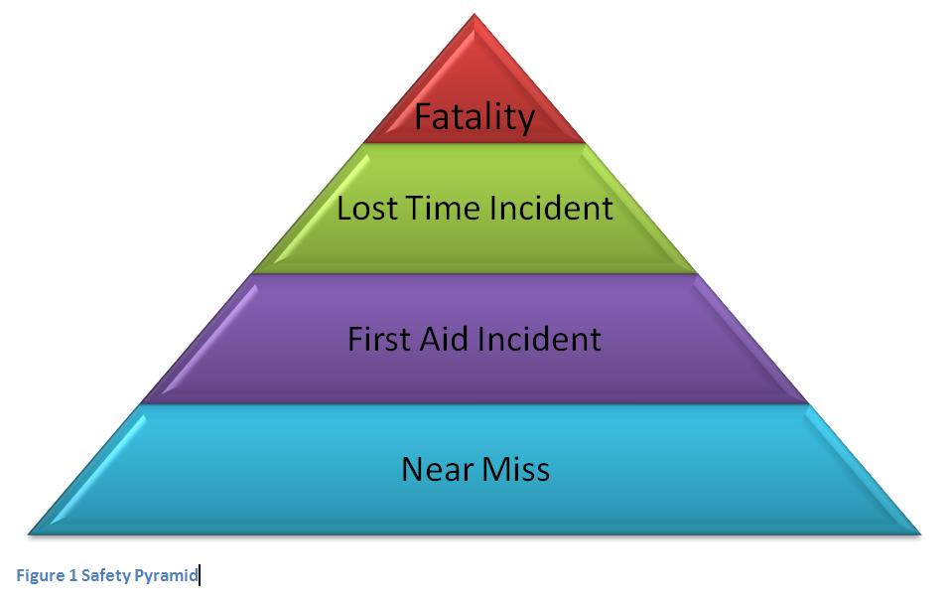
What is a Near Miss?
A near miss could be the next accident
Near misses are incidents or events that could have resulted in injuries or other adverse consequences, but fortunately did not.

Slide 34


Introducing
Nice Catch, Tiger! APP
Easy way to report near misses
Share best practices across all campus
Encourages collaboration among peers
Reward program for those reporting
Develop database to track near misses and identify trends.

Slide 35


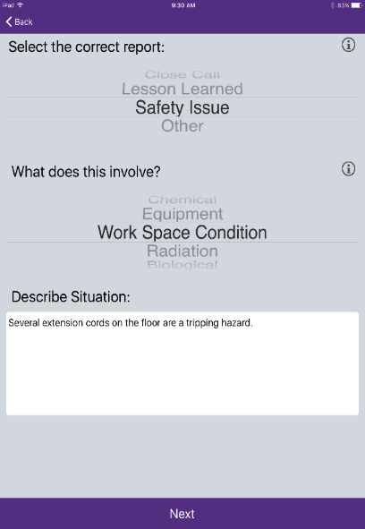
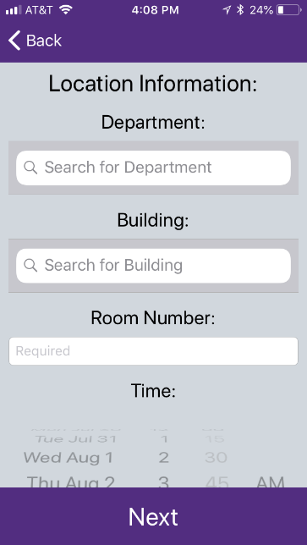
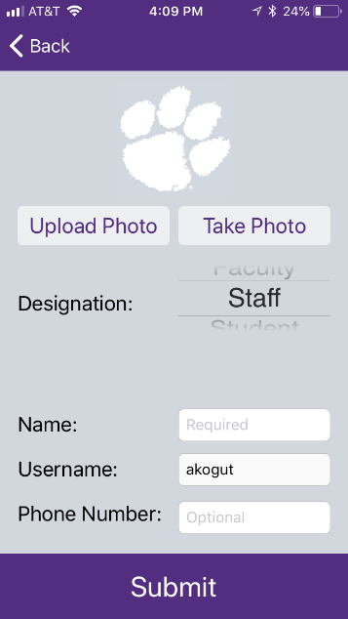
Nice Catch Tiger!
IN ACTION
Figure 2 – Nice Catch, Tiger! Homepage
Figure 3 – Nice Catch, Tiger! About Page
Figure 6 – Reporting Page 1

Slide 36
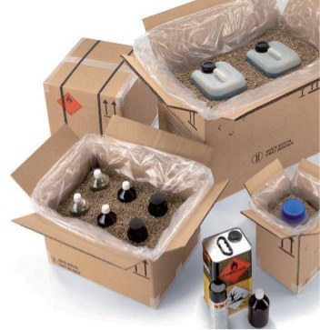
HAZARDOUS MATERIALS MANAGEMENT
Hazardous Materials is made up of multiple areas involving hazardous materials. These areas include but are not limited to hazardous waste, hazardous materials shipping, construction materials, remediations and biological wastes.
Areas that may apply to the Art Department are Hazardous Waste and Hazardous Materials Shipping.
Anyone shipping hazardous materials at
any Clemson University facility must trained
and certified by the University to do so.
Please contact Research Safety for this
training or information.
Notes:
Editorial Guidelines on Bullets:
1. Vertical lists are best introduced by a grammatically complete sentence followed by a colon. No periods
are required at the end of entries unless at least one entry is a complete sentence, in which case a period
is necessary at the end of each entry.
Example: A university can be judged by three measures:
· The quality of its students
· The quality of it faculty
· The quality of its infrastructure
2. If a list completes the sentence that introduces it, items begin with lowercase letters, commas or semicolons
(if individual items contain commas) are used to separate each item, and the last item ends with a period.
Note that the introductory clause does not end with a colon.
Example: A university can be judged by
· the quality of its students,
· the quality of its faculty,
· the quality of its infrastructure.
3. Avoid mixing sentence and nonsentence items in a bulleted list.
36

Slide 37
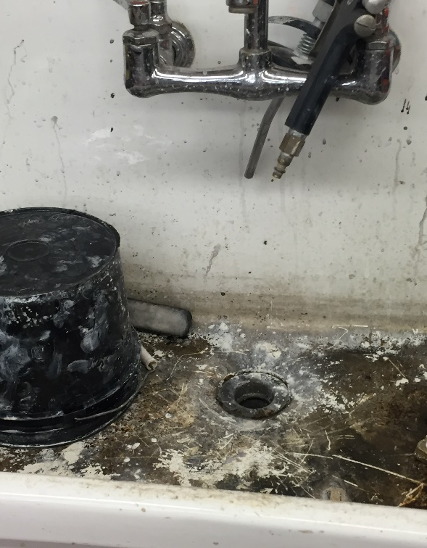
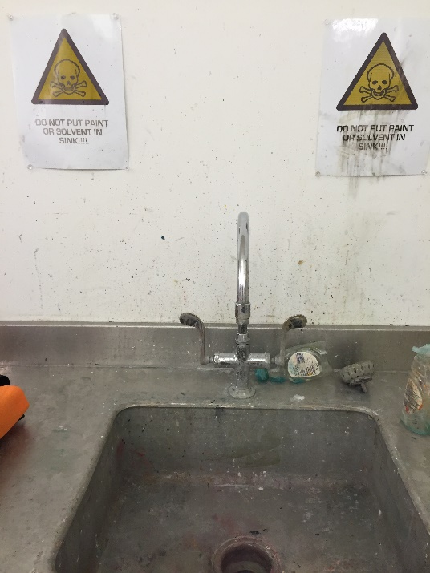
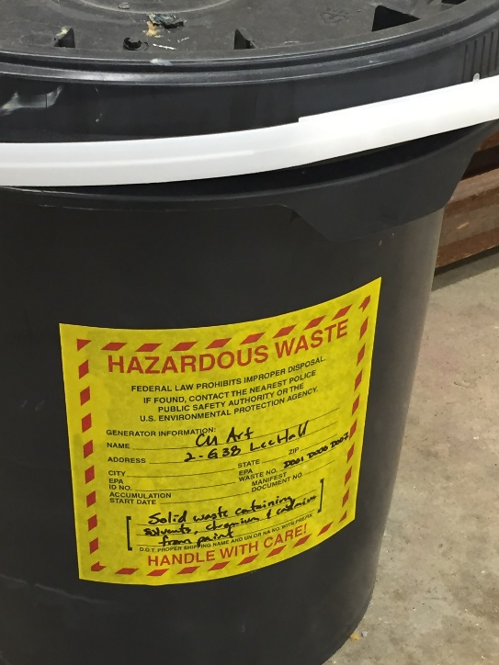
What is Hazardous Waste?
Hazardous waste is waste that is dangerous or potentially harmful to our health or the environment.
A chemical/hazardous material that is ready for disposal, must dispose of as a Hazardous Waste. NO drain or dumpster disposal!
Notes:
Editorial Guidelines on Bullets:
1. Vertical lists are best introduced by a grammatically complete sentence followed by a colon. No periods
are required at the end of entries unless at least one entry is a complete sentence, in which case a period
is necessary at the end of each entry.
Example: A university can be judged by three measures:
· The quality of its students
· The quality of it faculty
· The quality of its infrastructure
2. If a list completes the sentence that introduces it, items begin with lowercase letters, commas or semicolons
(if individual items contain commas) are used to separate each item, and the last item ends with a period.
Note that the introductory clause does not end with a colon.
Example: A university can be judged by
· the quality of its students,
· the quality of its faculty,
· the quality of its infrastructure.
3. Avoid mixing sentence and nonsentence items in a bulleted list.
37

Slide 38
Laws/Regulations requiring us to manage our Hazardous Waste
RCRA (Resource Conservation and Recovery Act) mandated by EPA
SCHWMR (South Carolina Hazardous Waste Management Regulations) mandated by state
CERCLA (Comprehensive Environmental Response, Clean Up and Liability Act) mandated by EPA
TSCA (Toxic Substance Control Act) EPA
FIFRA (Federal Insecticide, Fungicide and Rodenticide Act) EPA
CAA (Clean Air Act) EPA
CWA (Clean Water Act) EPA
Clemson University Waste Water Treatment Plant Discharge Permit-SCDHEC (NPDES)
Notes:
Editorial Guidelines on Bullets:
1. Vertical lists are best introduced by a grammatically complete sentence followed by a colon. No periods
are required at the end of entries unless at least one entry is a complete sentence, in which case a period
is necessary at the end of each entry.
Example: A university can be judged by three measures:
· The quality of its students
· The quality of it faculty
· The quality of its infrastructure
2. If a list completes the sentence that introduces it, items begin with lowercase letters, commas or semicolons
(if individual items contain commas) are used to separate each item, and the last item ends with a period.
Note that the introductory clause does not end with a colon.
Example: A university can be judged by
· the quality of its students,
· the quality of its faculty,
· the quality of its infrastructure.
3. Avoid mixing sentence and nonsentence items in a bulleted list.
38

Slide 39
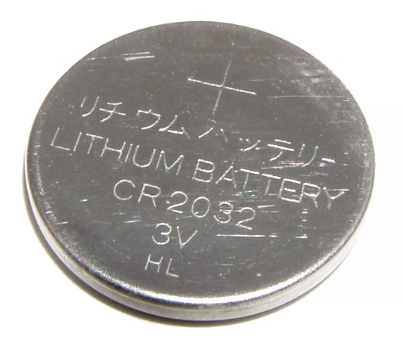
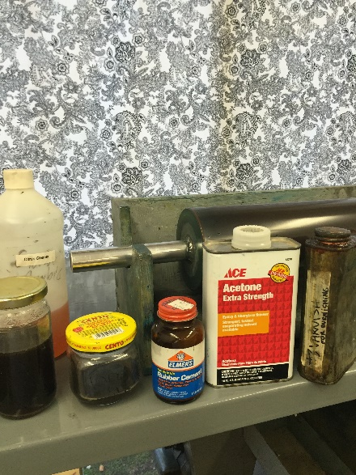
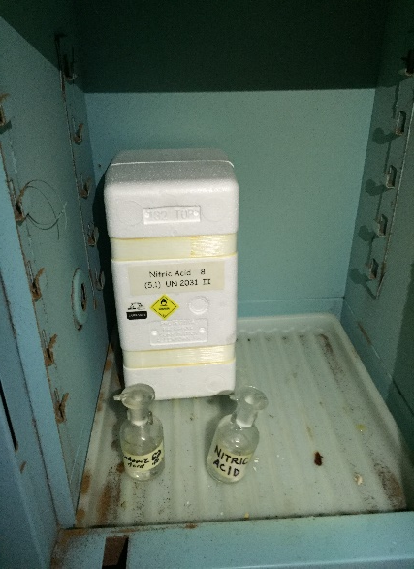
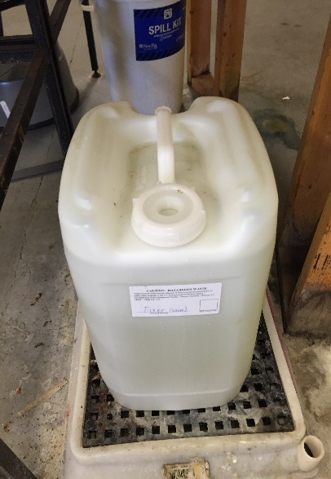
Types of Hazardous Waste
Characteristic Waste
Ignitable (Flammables/Oxidizers)
Corrosive (Acids/Bases)
Toxic (RCRA D-listed)
Reactive
Notes:
Editorial Guidelines on Bullets:
1. Vertical lists are best introduced by a grammatically complete sentence followed by a colon. No periods
are required at the end of entries unless at least one entry is a complete sentence, in which case a period
is necessary at the end of each entry.
Example: A university can be judged by three measures:
· The quality of its students
· The quality of it faculty
· The quality of its infrastructure
2. If a list completes the sentence that introduces it, items begin with lowercase letters, commas or semicolons
(if individual items contain commas) are used to separate each item, and the last item ends with a period.
Note that the introductory clause does not end with a colon.
Example: A university can be judged by
· the quality of its students,
· the quality of its faculty,
· the quality of its infrastructure.
3. Avoid mixing sentence and nonsentence items in a bulleted list.
39

Slide 40
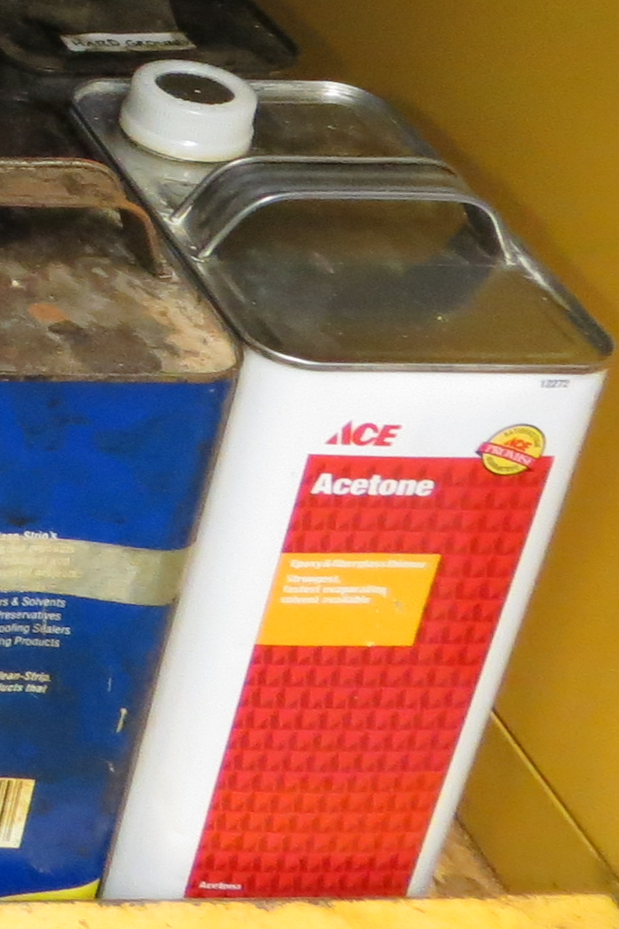

Types of Hazardous Waste Continued
Listed Wastes
F-List
P-List
U-Listed
CERCLA Wastes
Any chemical wastes that do not meet the definition of a RCRA characteristic or listed waste.
Notes:
Editorial Guidelines on Bullets:
1. Vertical lists are best introduced by a grammatically complete sentence followed by a colon. No periods
are required at the end of entries unless at least one entry is a complete sentence, in which case a period
is necessary at the end of each entry.
Example: A university can be judged by three measures:
· The quality of its students
· The quality of it faculty
· The quality of its infrastructure
2. If a list completes the sentence that introduces it, items begin with lowercase letters, commas or semicolons
(if individual items contain commas) are used to separate each item, and the last item ends with a period.
Note that the introductory clause does not end with a colon.
Example: A university can be judged by
· the quality of its students,
· the quality of its faculty,
· the quality of its infrastructure.
3. Avoid mixing sentence and nonsentence items in a bulleted list.
40

Slide 41
Generator (That’s you!)Responsibilities
Hazardous Waste Container Selection
Proper Management of Container while at Satellite Accumulation Area:
  Labeling
  Closed Container
  Integrity of Container
  Segregation
  Secondary Containment
  Declare Hazardous Waste to Research Safety
Notes:
Editorial Guidelines on Bullets:
1. Vertical lists are best introduced by a grammatically complete sentence followed by a colon. No periods
are required at the end of entries unless at least one entry is a complete sentence, in which case a period
is necessary at the end of each entry.
Example: A university can be judged by three measures:
· The quality of its students
· The quality of it faculty
· The quality of its infrastructure
2. If a list completes the sentence that introduces it, items begin with lowercase letters, commas or semicolons
(if individual items contain commas) are used to separate each item, and the last item ends with a period.
Note that the introductory clause does not end with a colon.
Example: A university can be judged by
· the quality of its students,
· the quality of its faculty,
· the quality of its infrastructure.
3. Avoid mixing sentence and nonsentence items in a bulleted list.
41

Slide 42
Generator Responsibilities Continued
Labeling
  A hazardous waste label or the words “Hazardous Waste” must be applied to the container when the first drop of waste is added to it or in the case of an unused chemical, as soon as you decide it is no longer needed.
  All chemical constituents must be listed on the container. Percentages of each constituent should also be listed.
  Chemical names, NOT ABBREVIATIONS, must be used.
  The hazard(s) of the Hazardous Waste Stream, i.e. flammable, corrosive, toxic, oxidizer, reactive, etc., must also be marked on the container. (The generator is responsible for making the hazard determination(s) of their waste streams.)
Notes:
Editorial Guidelines on Bullets:
1. Vertical lists are best introduced by a grammatically complete sentence followed by a colon. No periods
are required at the end of entries unless at least one entry is a complete sentence, in which case a period
is necessary at the end of each entry.
Example: A university can be judged by three measures:
· The quality of its students
· The quality of it faculty
· The quality of its infrastructure
2. If a list completes the sentence that introduces it, items begin with lowercase letters, commas or semicolons
(if individual items contain commas) are used to separate each item, and the last item ends with a period.
Note that the introductory clause does not end with a colon.
Example: A university can be judged by
· the quality of its students,
· the quality of its faculty,
· the quality of its infrastructure.
3. Avoid mixing sentence and nonsentence items in a bulleted list.
42

Slide 43
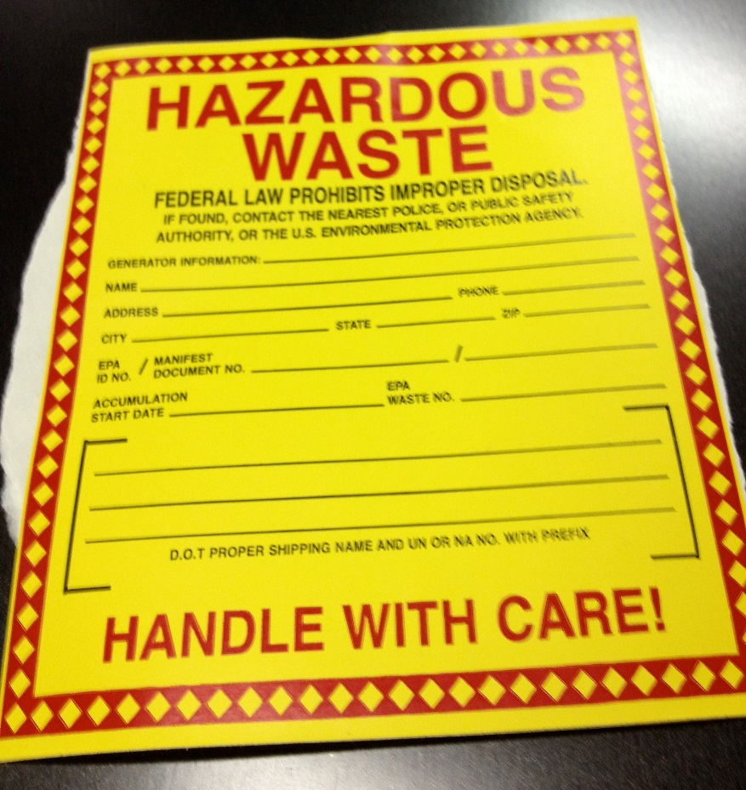
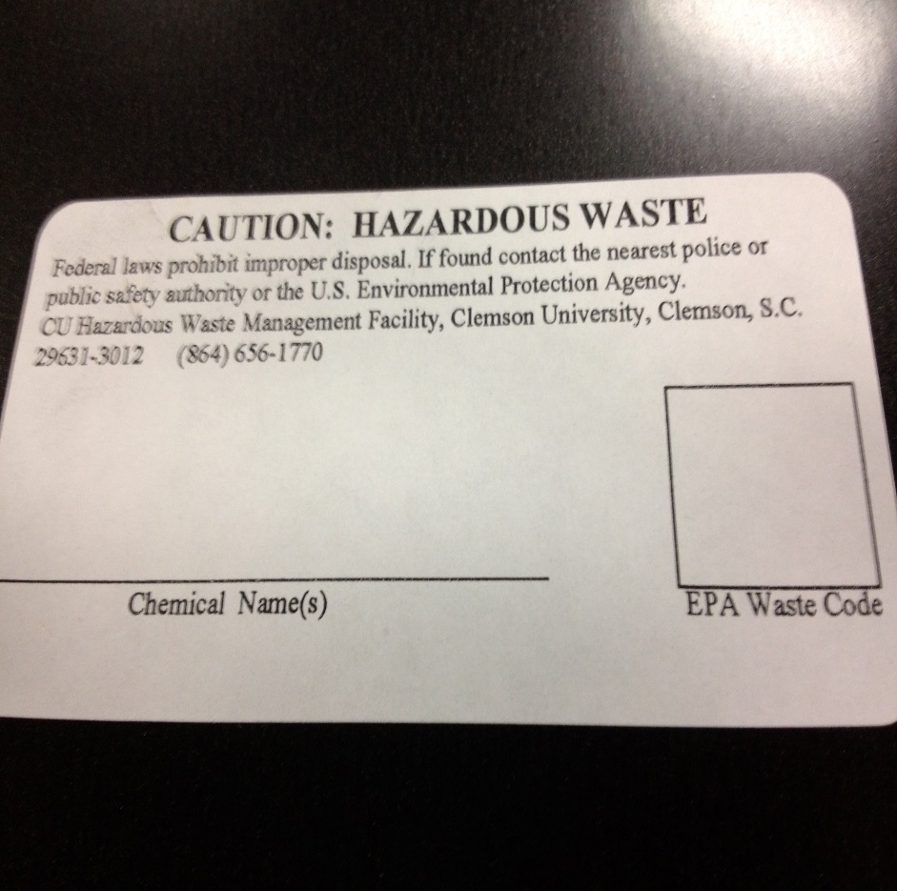
Generator Responsibilities Continued
Notes:
Editorial Guidelines on Bullets:
1. Vertical lists are best introduced by a grammatically complete sentence followed by a colon. No periods
are required at the end of entries unless at least one entry is a complete sentence, in which case a period
is necessary at the end of each entry.
Example: A university can be judged by three measures:
· The quality of its students
· The quality of it faculty
· The quality of its infrastructure
2. If a list completes the sentence that introduces it, items begin with lowercase letters, commas or semicolons
(if individual items contain commas) are used to separate each item, and the last item ends with a period.
Note that the introductory clause does not end with a colon.
Example: A university can be judged by
· the quality of its students,
· the quality of its faculty,
· the quality of its infrastructure.
3. Avoid mixing sentence and nonsentence items in a bulleted list.
43

Slide 44
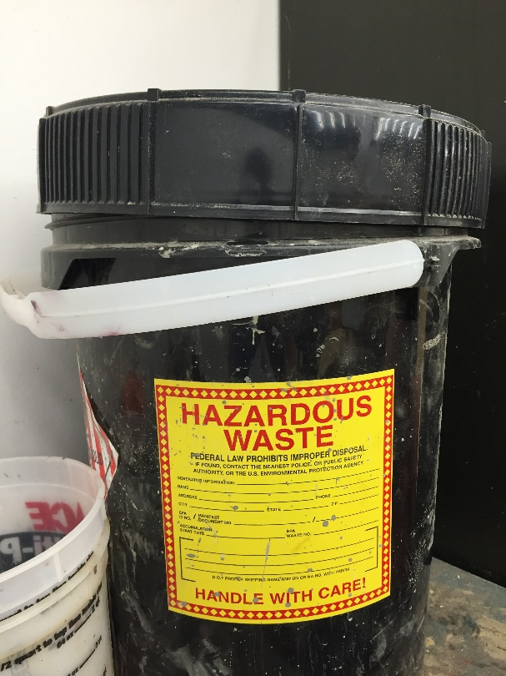
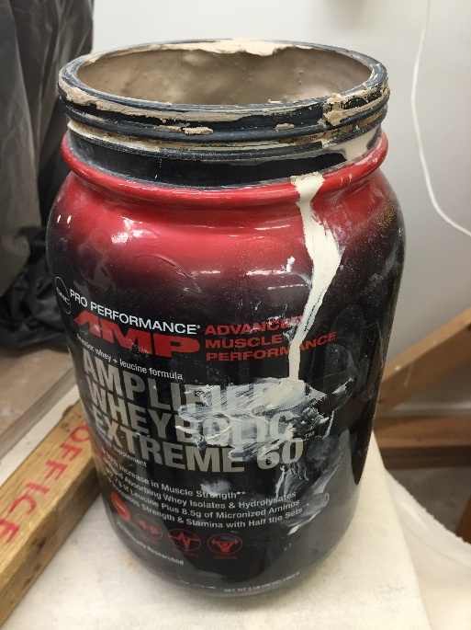
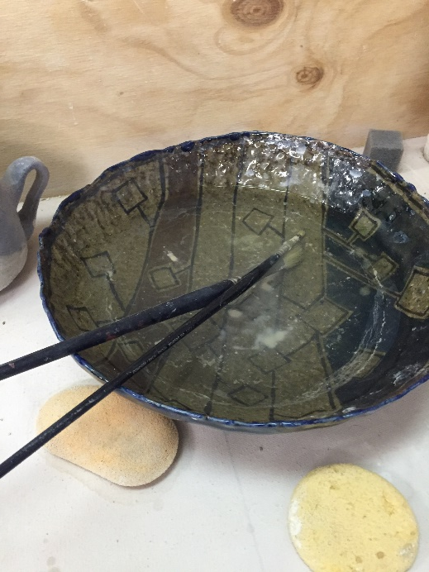
Generator Responsibilities Continued
KEEP CONTAINERS TIGHTLY CLOSED
Closed is defined as the lid is attached/secured in such a way that if tipped or knocked over nothing leaks out.
Notes:
Editorial Guidelines on Bullets:
1. Vertical lists are best introduced by a grammatically complete sentence followed by a colon. No periods
are required at the end of entries unless at least one entry is a complete sentence, in which case a period
is necessary at the end of each entry.
Example: A university can be judged by three measures:
· The quality of its students
· The quality of it faculty
· The quality of its infrastructure
2. If a list completes the sentence that introduces it, items begin with lowercase letters, commas or semicolons
(if individual items contain commas) are used to separate each item, and the last item ends with a period.
Note that the introductory clause does not end with a colon.
Example: A university can be judged by
· the quality of its students,
· the quality of its faculty,
· the quality of its infrastructure.
3. Avoid mixing sentence and nonsentence items in a bulleted list.
44

Slide 45


Generator Responsibilities Continued
Hazardous Waste Segregation
All hazardous waste must be stored in such a way so as to prevent incompatibles from coming into contact with each other.
Notes:
Editorial Guidelines on Bullets:
1. Vertical lists are best introduced by a grammatically complete sentence followed by a colon. No periods
are required at the end of entries unless at least one entry is a complete sentence, in which case a period
is necessary at the end of each entry.
Example: A university can be judged by three measures:
· The quality of its students
· The quality of it faculty
· The quality of its infrastructure
2. If a list completes the sentence that introduces it, items begin with lowercase letters, commas or semicolons
(if individual items contain commas) are used to separate each item, and the last item ends with a period.
Note that the introductory clause does not end with a colon.
Example: A university can be judged by
· the quality of its students,
· the quality of its faculty,
· the quality of its infrastructure.
3. Avoid mixing sentence and nonsentence items in a bulleted list.
45

Slide 46


Generator Responsibilities Continued
Secondary Containment
All liquid Hazardous Waste must be kept in secondary containment. This containment must be compatible with the hazardous waste stream it holds.
It MUST also be able to hold 10% of the total volume (if one container) or 100% total volume of the largest container (if more than one container).
Notes:
Editorial Guidelines on Bullets:
1. Vertical lists are best introduced by a grammatically complete sentence followed by a colon. No periods
are required at the end of entries unless at least one entry is a complete sentence, in which case a period
is necessary at the end of each entry.
Example: A university can be judged by three measures:
· The quality of its students
· The quality of it faculty
· The quality of its infrastructure
2. If a list completes the sentence that introduces it, items begin with lowercase letters, commas or semicolons
(if individual items contain commas) are used to separate each item, and the last item ends with a period.
Note that the introductory clause does not end with a colon.
Example: A university can be judged by
· the quality of its students,
· the quality of its faculty,
· the quality of its infrastructure.
3. Avoid mixing sentence and nonsentence items in a bulleted list.
46

Slide 47
Generator Responsibilities Continued
Declare Hazardous Waste to Research Safety
Hazardous Waste must be declared in writing to Research Safety for removal from the Satellite Accumulation Area.
Online Request Form:
http://www.clemson.edu/research/safety/hazardouswaste
This form meets the requirement for documentation of hazard determination, serves as a transportation document that allows us to transport from your lab to the Accumulation Area, and an emergency document in case of incident during transport.
Notes:
Editorial Guidelines on Bullets:
1. Vertical lists are best introduced by a grammatically complete sentence followed by a colon. No periods
are required at the end of entries unless at least one entry is a complete sentence, in which case a period
is necessary at the end of each entry.
Example: A university can be judged by three measures:
· The quality of its students
· The quality of it faculty
· The quality of its infrastructure
2. If a list completes the sentence that introduces it, items begin with lowercase letters, commas or semicolons
(if individual items contain commas) are used to separate each item, and the last item ends with a period.
Note that the introductory clause does not end with a colon.
Example: A university can be judged by
· the quality of its students,
· the quality of its faculty,
· the quality of its infrastructure.
3. Avoid mixing sentence and nonsentence items in a bulleted list.
47

Slide 48



Inherently Waste-Like
Something may become a waste because it is discarded, abandoned, or considered inherently waste-like:
Notes:
Editorial Guidelines on Bullets:
1. Vertical lists are best introduced by a grammatically complete sentence followed by a colon. No periods
are required at the end of entries unless at least one entry is a complete sentence, in which case a period
is necessary at the end of each entry.
Example: A university can be judged by three measures:
· The quality of its students
· The quality of it faculty
· The quality of its infrastructure
2. If a list completes the sentence that introduces it, items begin with lowercase letters, commas or semicolons
(if individual items contain commas) are used to separate each item, and the last item ends with a period.
Note that the introductory clause does not end with a colon.
Example: A university can be judged by
· the quality of its students,
· the quality of its faculty,
· the quality of its infrastructure.
3. Avoid mixing sentence and nonsentence items in a bulleted list.
48

Slide 49


Unknowns
DO NOT GUESS AT THE IDENTITY OR “CREATE” A NAME FOR AN UNKNOWN!
Notes:
Editorial Guidelines on Bullets:
1. Vertical lists are best introduced by a grammatically complete sentence followed by a colon. No periods
are required at the end of entries unless at least one entry is a complete sentence, in which case a period
is necessary at the end of each entry.
Example: A university can be judged by three measures:
· The quality of its students
· The quality of it faculty
· The quality of its infrastructure
2. If a list completes the sentence that introduces it, items begin with lowercase letters, commas or semicolons
(if individual items contain commas) are used to separate each item, and the last item ends with a period.
Note that the introductory clause does not end with a colon.
Example: A university can be judged by
· the quality of its students,
· the quality of its faculty,
· the quality of its infrastructure.
3. Avoid mixing sentence and nonsentence items in a bulleted list.
49

Slide 50


Empty Containers
An empty container is any container which meets RCRA’s definition of empty and did not hold any acutely toxic (P-listed) waste.
An empty container that has held a P-Listed waste must be managed as a Hazardous Waste!
Notes:
Editorial Guidelines on Bullets:
1. Vertical lists are best introduced by a grammatically complete sentence followed by a colon. No periods
are required at the end of entries unless at least one entry is a complete sentence, in which case a period
is necessary at the end of each entry.
Example: A university can be judged by three measures:
· The quality of its students
· The quality of it faculty
· The quality of its infrastructure
2. If a list completes the sentence that introduces it, items begin with lowercase letters, commas or semicolons
(if individual items contain commas) are used to separate each item, and the last item ends with a period.
Note that the introductory clause does not end with a colon.
Example: A university can be judged by
· the quality of its students,
· the quality of its faculty,
· the quality of its infrastructure.
3. Avoid mixing sentence and nonsentence items in a bulleted list.
50

Slide 51
Spill Incident Response
Clemson University Fire Department is the Hazardous Materials Response Team for main campus. In the event of a spill please contact CUFD by dialing 911 or 656-2222.
Notes:
Editorial Guidelines on Bullets:
1. Vertical lists are best introduced by a grammatically complete sentence followed by a colon. No periods
are required at the end of entries unless at least one entry is a complete sentence, in which case a period
is necessary at the end of each entry.
Example: A university can be judged by three measures:
· The quality of its students
· The quality of it faculty
· The quality of its infrastructure
2. If a list completes the sentence that introduces it, items begin with lowercase letters, commas or semicolons
(if individual items contain commas) are used to separate each item, and the last item ends with a period.
Note that the introductory clause does not end with a colon.
Example: A university can be judged by
· the quality of its students,
· the quality of its faculty,
· the quality of its infrastructure.
3. Avoid mixing sentence and nonsentence items in a bulleted list.
51

Slide 52


Hazardous Wastes Found in Arts
Notes:
Editorial Guidelines on Bullets:
1. Vertical lists are best introduced by a grammatically complete sentence followed by a colon. No periods
are required at the end of entries unless at least one entry is a complete sentence, in which case a period
is necessary at the end of each entry.
Example: A university can be judged by three measures:
· The quality of its students
· The quality of it faculty
· The quality of its infrastructure
2. If a list completes the sentence that introduces it, items begin with lowercase letters, commas or semicolons
(if individual items contain commas) are used to separate each item, and the last item ends with a period.
Note that the introductory clause does not end with a colon.
Example: A university can be judged by
· the quality of its students,
· the quality of its faculty,
· the quality of its infrastructure.
3. Avoid mixing sentence and nonsentence items in a bulleted list.
52

Slide 53


Hazardous Wastes Found in Arts
Notes:
Editorial Guidelines on Bullets:
1. Vertical lists are best introduced by a grammatically complete sentence followed by a colon. No periods
are required at the end of entries unless at least one entry is a complete sentence, in which case a period
is necessary at the end of each entry.
Example: A university can be judged by three measures:
· The quality of its students
· The quality of it faculty
· The quality of its infrastructure
2. If a list completes the sentence that introduces it, items begin with lowercase letters, commas or semicolons
(if individual items contain commas) are used to separate each item, and the last item ends with a period.
Note that the introductory clause does not end with a colon.
Example: A university can be judged by
· the quality of its students,
· the quality of its faculty,
· the quality of its infrastructure.
3. Avoid mixing sentence and nonsentence items in a bulleted list.
53

Slide 54


Hazardous Wastes Found in Arts
Notes:
Editorial Guidelines on Bullets:
1. Vertical lists are best introduced by a grammatically complete sentence followed by a colon. No periods
are required at the end of entries unless at least one entry is a complete sentence, in which case a period
is necessary at the end of each entry.
Example: A university can be judged by three measures:
· The quality of its students
· The quality of it faculty
· The quality of its infrastructure
2. If a list completes the sentence that introduces it, items begin with lowercase letters, commas or semicolons
(if individual items contain commas) are used to separate each item, and the last item ends with a period.
Note that the introductory clause does not end with a colon.
Example: A university can be judged by
· the quality of its students,
· the quality of its faculty,
· the quality of its infrastructure.
3. Avoid mixing sentence and nonsentence items in a bulleted list.
54

Slide 55

KUDOS!!!
Notes:
Editorial Guidelines on Bullets:
1. Vertical lists are best introduced by a grammatically complete sentence followed by a colon. No periods
are required at the end of entries unless at least one entry is a complete sentence, in which case a period
is necessary at the end of each entry.
Example: A university can be judged by three measures:
· The quality of its students
· The quality of it faculty
· The quality of its infrastructure
2. If a list completes the sentence that introduces it, items begin with lowercase letters, commas or semicolons
(if individual items contain commas) are used to separate each item, and the last item ends with a period.
Note that the introductory clause does not end with a colon.
Example: A university can be judged by
· the quality of its students,
· the quality of its faculty,
· the quality of its infrastructure.
3. Avoid mixing sentence and nonsentence items in a bulleted list.
55

Slide 56

KUDOS
Notes:
Editorial Guidelines on Bullets:
1. Vertical lists are best introduced by a grammatically complete sentence followed by a colon. No periods
are required at the end of entries unless at least one entry is a complete sentence, in which case a period
is necessary at the end of each entry.
Example: A university can be judged by three measures:
· The quality of its students
· The quality of it faculty
· The quality of its infrastructure
2. If a list completes the sentence that introduces it, items begin with lowercase letters, commas or semicolons
(if individual items contain commas) are used to separate each item, and the last item ends with a period.
Note that the introductory clause does not end with a colon.
Example: A university can be judged by
· the quality of its students,
· the quality of its faculty,
· the quality of its infrastructure.
3. Avoid mixing sentence and nonsentence items in a bulleted list.
56

Slide 57
Hazardous Wastes Contacts:
June Brock-Carroll
Hazardous Materials Manager
juneb@clemson.edu
Logan O’Bryant
Hazardous Waste Specialist
lhobrya@clemosn.edu
Jonathan Mengering
Hazardous Materials Specialist
mengeri@clemson.edu
Notes:
Editorial Guidelines on Bullets:
1. Vertical lists are best introduced by a grammatically complete sentence followed by a colon. No periods
are required at the end of entries unless at least one entry is a complete sentence, in which case a period
is necessary at the end of each entry.
Example: A university can be judged by three measures:
· The quality of its students
· The quality of it faculty
· The quality of its infrastructure
2. If a list completes the sentence that introduces it, items begin with lowercase letters, commas or semicolons
(if individual items contain commas) are used to separate each item, and the last item ends with a period.
Note that the introductory clause does not end with a colon.
Example: A university can be judged by
· the quality of its students,
· the quality of its faculty,
· the quality of its infrastructure.
3. Avoid mixing sentence and nonsentence items in a bulleted list.
57

Slide 58
Arts Department: with your attendance of a live training session
HAZCOM (Hazard Communication)– your responsibilities now that you have received training
Exposure Routes- valuable information to keep in mind
Hazardous Waste– your responsibilities now that you have received training
*If you did not attend a live training session, then you must complete the online trainings for HAZCOM (Hazard Communication) and Hazardous Waste, both are available on the ORS website.

Slide 59

Labeling Poster

Slide 60

Satellite Accumulation Area (SAA) Hazardous Waste Poster

Slide 61
http://www.clemson.edu/research/safety/
Office #: (864) 656-0341
Notes:
Editorial Guidelines on Bullets:
1. Vertical lists are best introduced by a grammatically complete sentence followed by a colon. No periods
are required at the end of entries unless at least one entry is a complete sentence, in which case a period
is necessary at the end of each entry.
Example: A university can be judged by three measures:
· The quality of its students
· The quality of it faculty
· The quality of its infrastructure
2. If a list completes the sentence that introduces it, items begin with lowercase letters, commas or semicolons
(if individual items contain commas) are used to separate each item, and the last item ends with a period.
Note that the introductory clause does not end with a colon.
Example: A university can be judged by
· the quality of its students,
· the quality of its faculty,
· the quality of its infrastructure.
3. Avoid mixing sentence and nonsentence items in a bulleted list.
61

